Slide 1
Downscaling techniques for retrieval of near-surface meteorological fields and turbulence parameters from atmospheric numerical model outputs
Jeremy A. Gibbs
School of Meteorology

Slide 2
Introduction
The WRF model → self-contained mesoscale modeling system
Flows encompassing global to fine scales

Slide 3
Introduction
Such capability is appealing to users for whom accurate prediction of turbulence effects is increasingly desirable
Air pollution
dispersive role of small-scale atmospheric motions
Remote sensing
accurate description of EM/acoustic wave propagation
BL dynamics, urban effects, and more

Slide 4
Introduction
How best to adequately represent motions in the range of scales O(≤ 100m) based on numerical model output?
How best to adequately reproduce realistic near-surface flow fields and turbulence parameters?
Several methods based on WRF model applications were evaluated

Slide 5
Tools
The WRF model (v3.4.1)
University of Oklahoma Large Eddy Simulation (OU-LES) code

Slide 6
WRF Model Run Options
Mesoscale modeling
horizontal grid spacing (∆) from 1 km to 4 km
WRF-LES (idealized)
horizontal grid spacing (∆) from 20 m to 80 m
WRF-LES nested in mesoscale WRF model
nested domains with ∆ from 12 km down to 40 m
Notes:
Ranges

Slide 7
OU-LES Run Options
Traditional LES (idealized)
horizontal grid spacing (∆) from 20 m to 80 m
Nudged LES (realistic CBL)
OU-LES (∆ = 40 m) is nudged with
RUC output
WRF model output

Slide 8
Object of Study
Stull (1988) defines the CBL as a mixed layer dominated by buoyant turbulence generation
LES approach has proven to be particularly relevant for the reproduction of daytime CBL flow types
Find optimal method to obtain near-surface turbulent fluctuations and parameters which are important for EM and acoustic wave propagation

Slide 9
Mesoscale Modeling: Background
Scales of motion associated with atmospheric turbulence are not resolved
Combined effects of subgrid turbulence must be modeled
Horizontal turbulent exchange → Smagorinsky-type closure
Vertical turbulent exchange → parameterized via turbulence (PBL) scheme
Notes:
Cheapest option
PBL schemes assume that an individual model grid cell contains a representative sample of subgrid turbulent motions
Smagorinsky is based on deformation of resolved flow

Slide 10
Mesoscale Modeling: Setup
Expanded work from previous studies
Gibbs (2008), Gibbs et al. (2011)
Five CBL cases investigated
Comparison domain centered over ARM site in Lamont, OK
WRF model output compared with observational and OU-LES data
Notes:
Four PBL schemes tested: YSU, MYJ, MYNN, TEMF
WRF: 101 x 101 x 41 (∆x = ∆y = 1 km), Initialized with NARR data (∆ ~ 32 km), 12-hr warm-start to reduce spin-up effects
LES: 512 x 512 x 80 (∆x = ∆y = 100 m, ∆z = 50m), Nudged with RUC data (∆ ~ 20 km)
OBS: SMOS, CO2FLX, ECOR

Slide 11
Mesoscale Modeling: Setup

Slide 12
Mesoscale Modeling: Discussion
Little value added for horizontal grid spacing refinement of 4 km → 1 km
These scales often reside within the maximum energy-containing spectral intervals of CBL motions
Notes:
Energy-containing = turbulence producing
Flow features are potentially neither sufficiently resolved explicitly nor correctly represented statistically as subgrid-scale phenomena (Wyngaard 2004)

Slide 13
Mesoscale Modeling: Discussion
WRF mean fields compared reasonably well with observational and LES data
Turbulence parameters indicated WRF generally failed to capture small-scale spatial variability of CBL flows
Non-local PBL scheme (YSU) performed the most admirably across a broad range of conditions
Notes:
Some issues with shallow PBL and cool bias
Findings match other studies (Shin and Hong 2011)

Slide 14
Large Eddy Simulation: Background
Historically, the LES approach has proven particularly relevant for the reproduction of CBL flow types
Equations of motion are filtered in physical space to remove smallest scales of the flow
Large scale eddies are explicitly resolved
Effects of small scales are modeled
Notes:
OU-LES uses implicit box filter (grid cutoff)
Small scales more favorable to generalized modeling
Given sufficient resolution, LES is assumed independent of SFS model

Slide 15
Idealized LES: Setup
CBL flows were reproduced using OU-LES and WRF-LES
Numerical domain: 10.24 × 10.24 × 2 km³
Initialized with same idealized profiles
Forcings were set equal and held constant
Effects of flow types (with/without shear) and of varying grid spacing were investigated
Notes:
Velocity spectra and other statistics compared

Slide 16
Idealized LES: Setup
Why Spectra?
Lack of verification data at these scales
Does model produce expected energy statistics?
Does model produce features consistent with realistic atmospheric dynamics?
Further allows investigation of model numerics and assessment of effective resolution
Notes:
Velocity spectra and other statistics compared

Slide 17
Idealized LES: Setup
Notes:
Come from WRF model idealized cases
Goal is to quickly spin-up a well-developed CBL

Slide 18
Idealized LES: Code Descriptions
 | OU-LES | WRF-LES
Governing Equations | Incompressible, Boussinesq | Compressible, Non-hydrostatic
Finite Difference Scheme | 2nd-order centered | 5th-order upwind
Integration Scheme | 3rd-order Runge-Kutta | 3rd-order Runge-Kutta (time-split)
Subgrid Scheme | 1.5-order TKE
Lateral Boundary Conditions | Periodic
Notes:
WRF model has several filters:
1.) 5th-order = 6th-order + Implicit diffusion term, Diffusion term proportional to the Courant number
2.) Time-averaging of vertically-implicit part of time-split equations slightly forward-centered
3.) Terms added to horizontal momentum equations that specifically damp 3D divergence (in terms of time derivative of pressure)
--- Modified pressure used in horizontal pressure-gradient terms
4.) Terms added to horizontal momentum equations that damp the vertically-integrated horizontal divergence

Slide 19
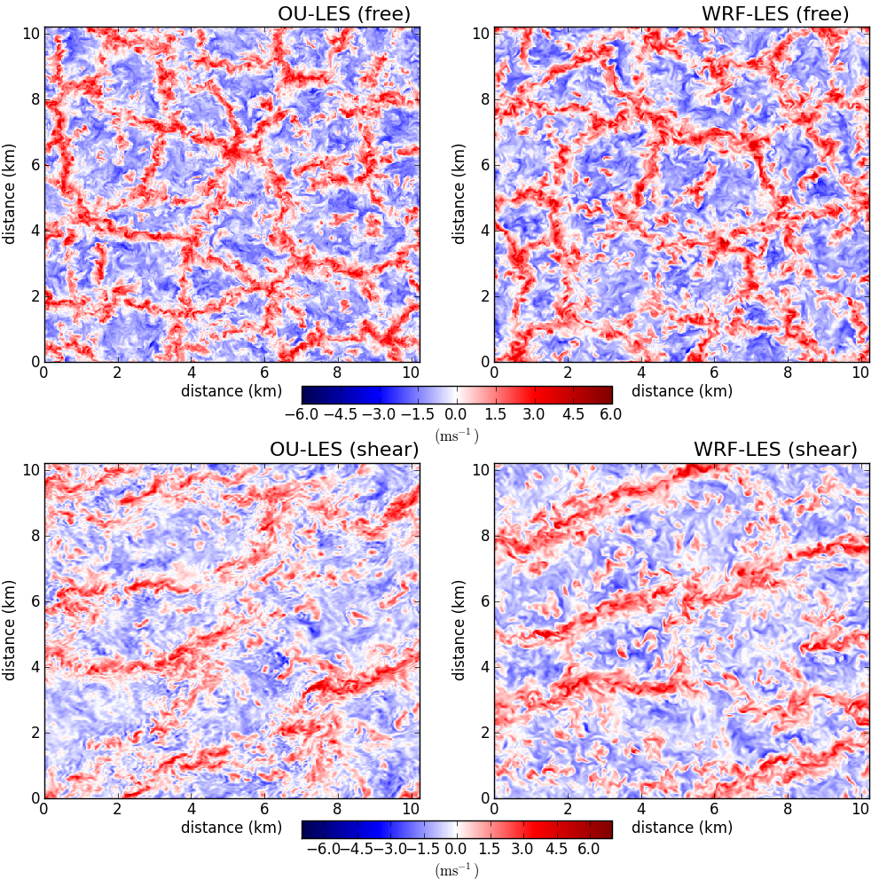
w-component velocity (z/zi = 0.25)
Notes:
Sample slice of final hour. Looks similar, right? Some signs of broader, less organized cellular convection for free, and slightly broader and elongated streaks in shear.

Slide 20
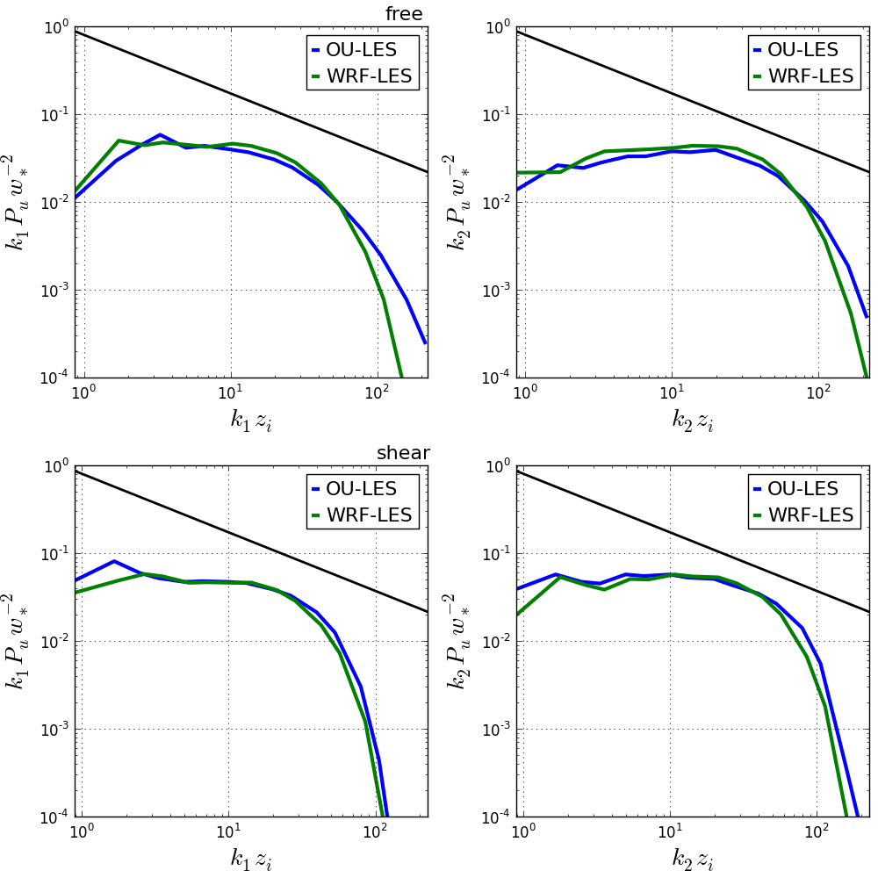
u-component: 1D spectral density (z/zi = 0.25)
Notes:
Free: both have narrower inertial sub-range and much sharper drop-off, more energy at larger scales
Shear: similar, but still drops off faster, transverse worse

Slide 21
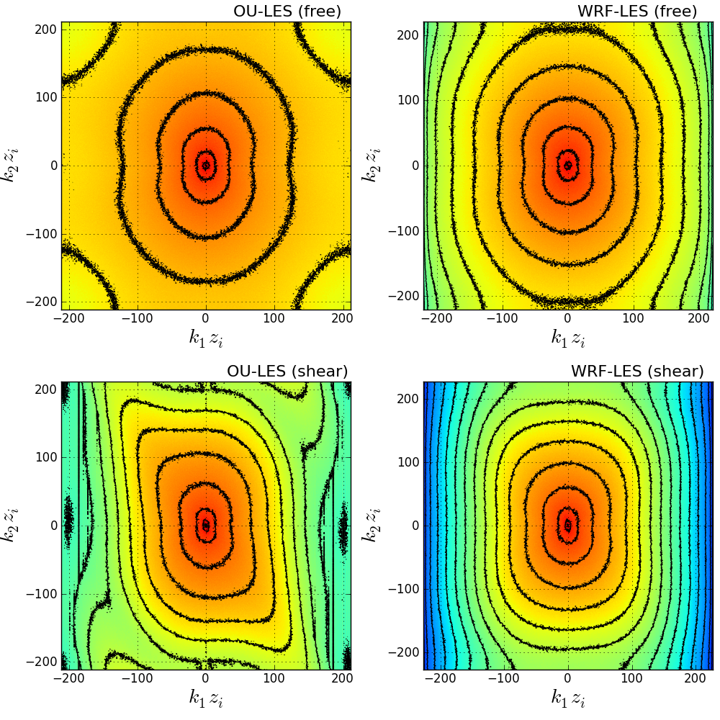
u-component: 2D spectral density (z/zi = 0.25)
Notes:
Note: elongated in transverse direction due to theory ~4/3 t/l
Free: WRF more concentrated near larger scales, and fast drop-off
Shear: Not as concentrated near larger scales, but drop-off occurs at smaller scales.
Note, spectra shifted in k2 direction, due to variability across rolls, these are small scale anisotropic effects that WRF washes out

Slide 22
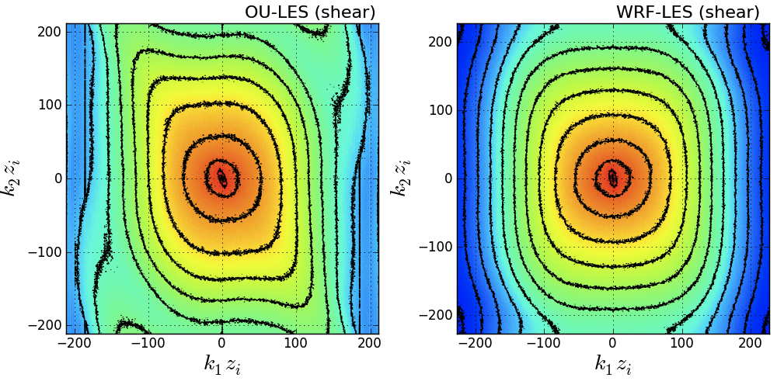
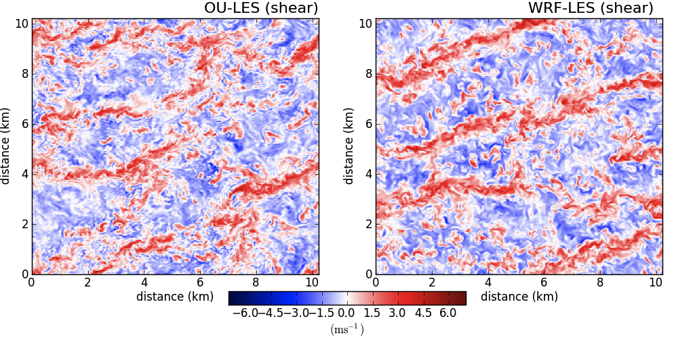
Notes:
For instance, air pollution applications, where dispersive role of small-scale motion may be very important, or wave propagation business, where structure-function parameter will not be right if small-scale motions are affected by numerical dissipation.

Slide 23
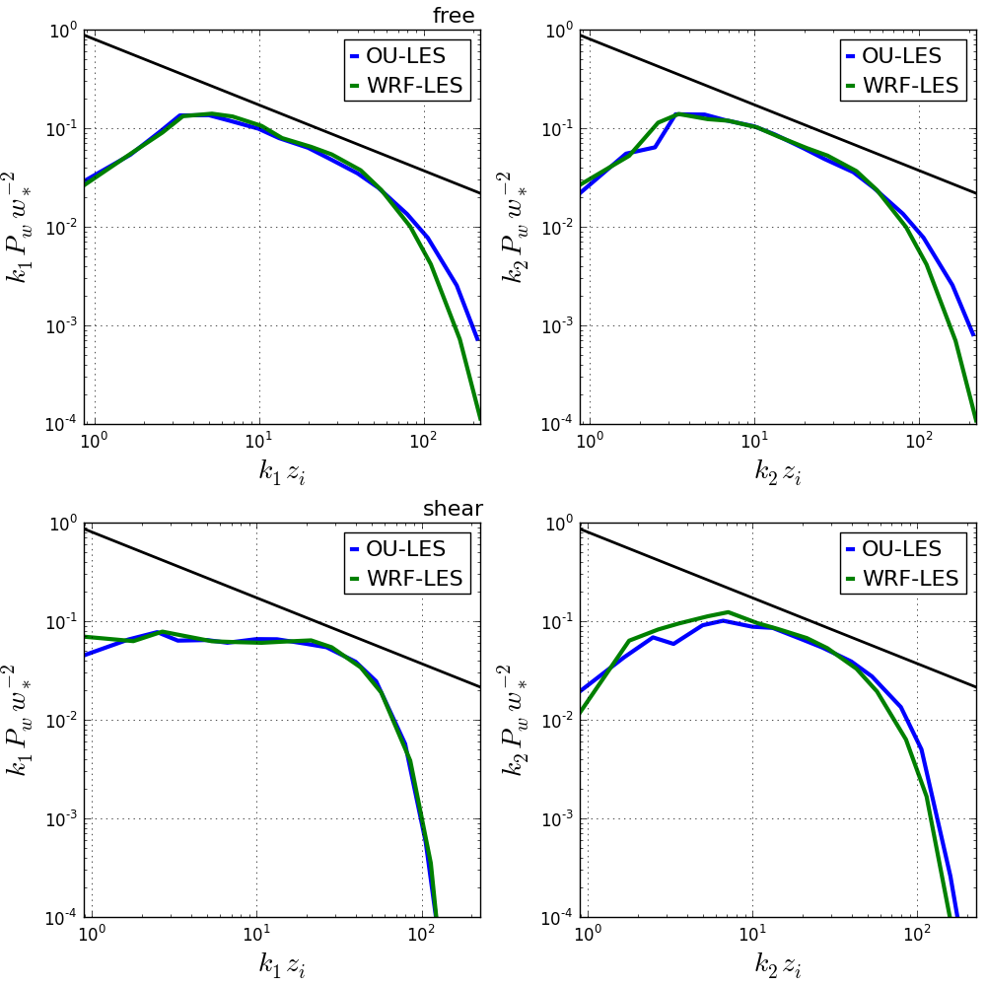
w-component: 1D spectral density (z/zi = 0.25)
Notes:
Free: both have narrower inertial sub-range and much sharper drop-off, more similar energy at larger scales
Shear: k1 direction almost matches exactly, in k2 direction get larger drop-off more energy at larger scales

Slide 24
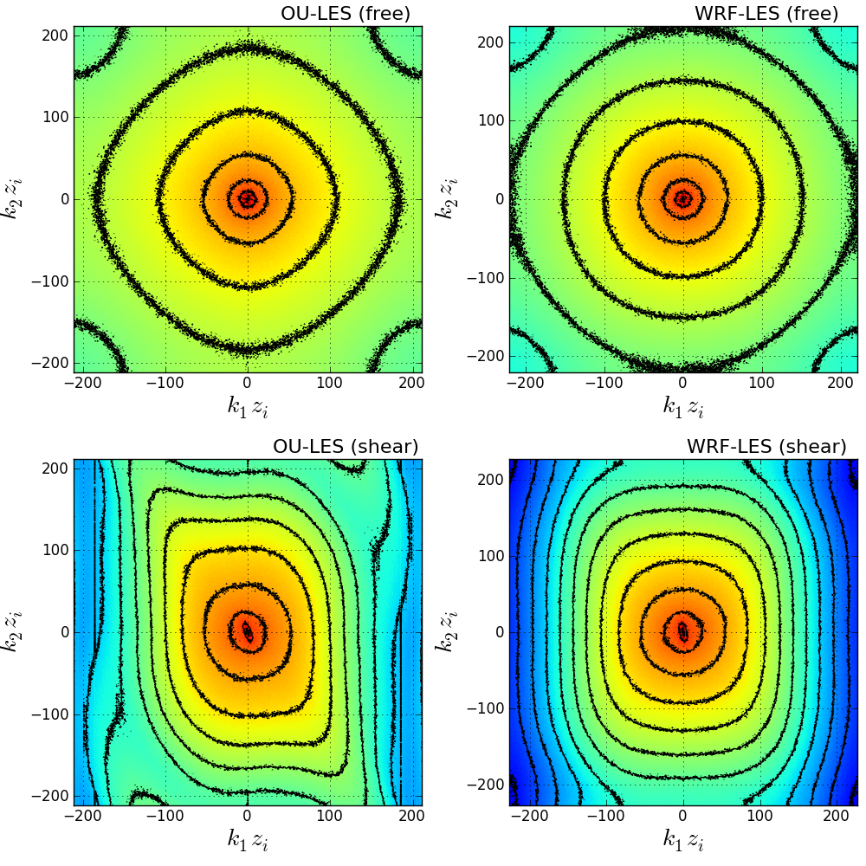
w-component: 2D spectral density (z/zi = 0.25)
Notes:
Note: not elongated because k1,k2 are both transverse
Free: WRF less more concentrated near larger scales, and fast drop-off
Shear: Not as concentrated near larger scales, but drop-off occurs at smaller scales.
Note, spectra shifted in k2 direction, due to variability across rolls, these are small scale anisotropic effects that WRF washes out

Slide 25
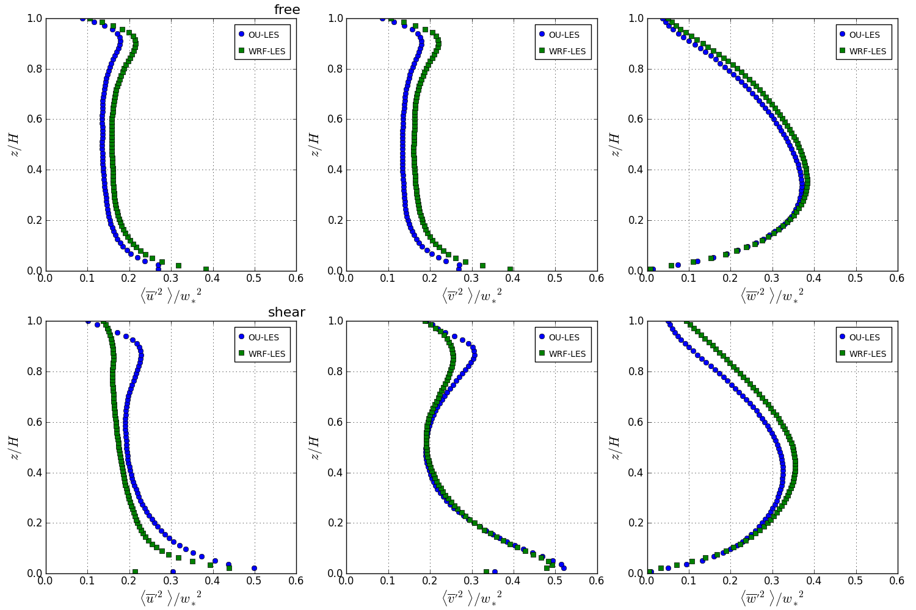
normalized velocity variance
Notes:
Free: u: WRF larger v: WRF larger w: similar at level of interest
Shear: u: OU larger v: similar w: WRF maybe slightly more at level of interest

Slide 26
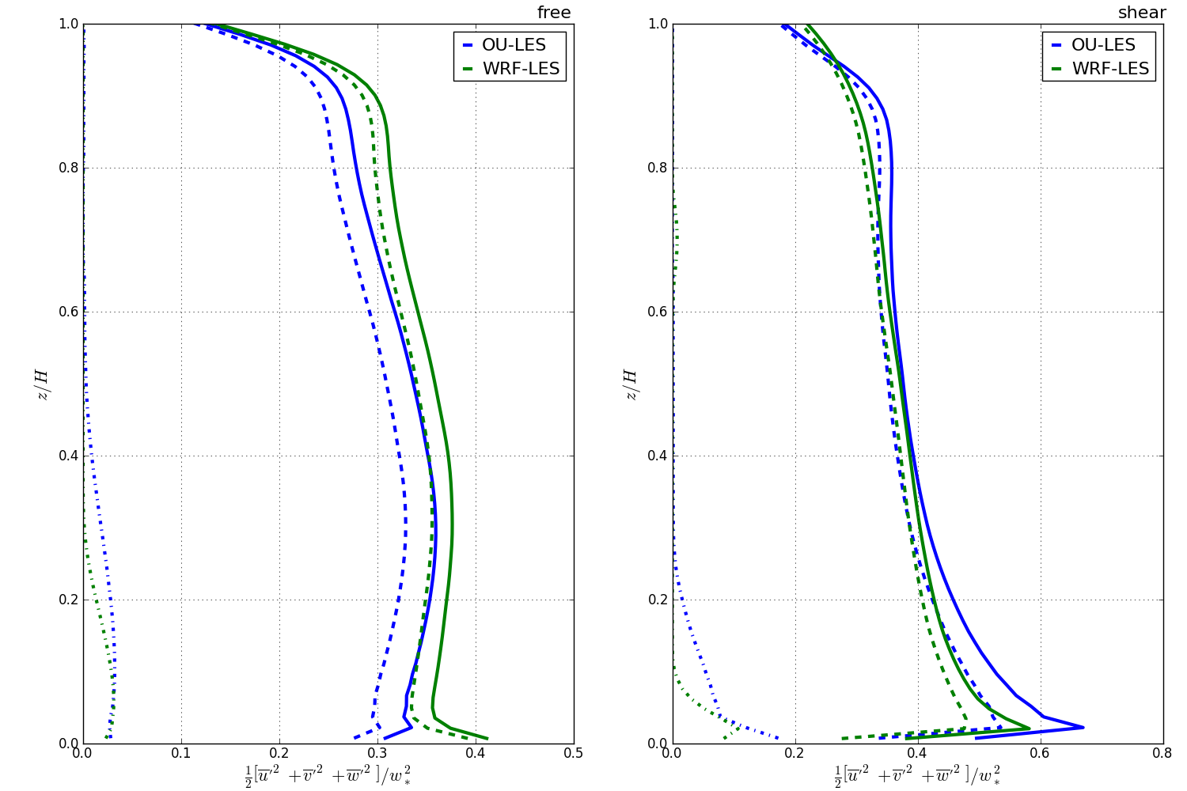
normalized turbulence kinetic energy
Notes:
Free: tke: WRF larger
Shear: tke: OU larger

Slide 27
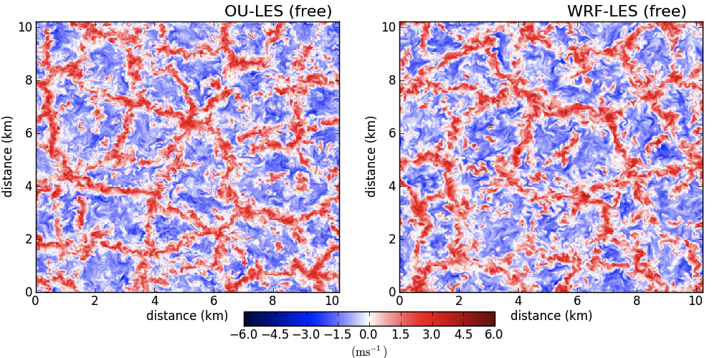
Discussion: Shear-Free
Visually, velocity patterns look similar

Slide 28
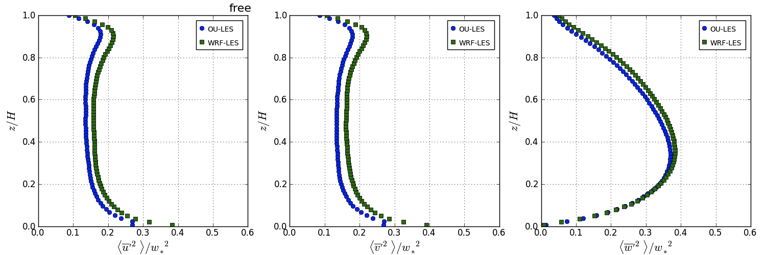
Discussion: Shear-Free
WRF-LES produced larger velocity variances, larger TKE
Notes:
For instance, air pollution applications, where dispersive role of small-scale motion may be very important, or wave propagation business, where structure-function parameter will not be right if small-scale motions are affected by numerical dissipation.

Slide 29
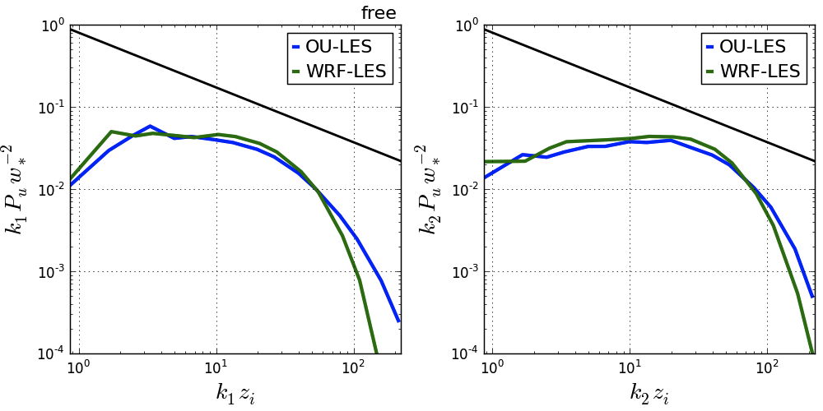
Discussion: Shear-Free
Spectra show that energy attributed to larger scales in WRF-LES as compared to OU-LES
Notes:
For instance, air pollution applications, where dispersive role of small-scale motion may be very important, or wave propagation business, where structure-function parameter will not be right if small-scale motions are affected by numerical dissipation.

Slide 30
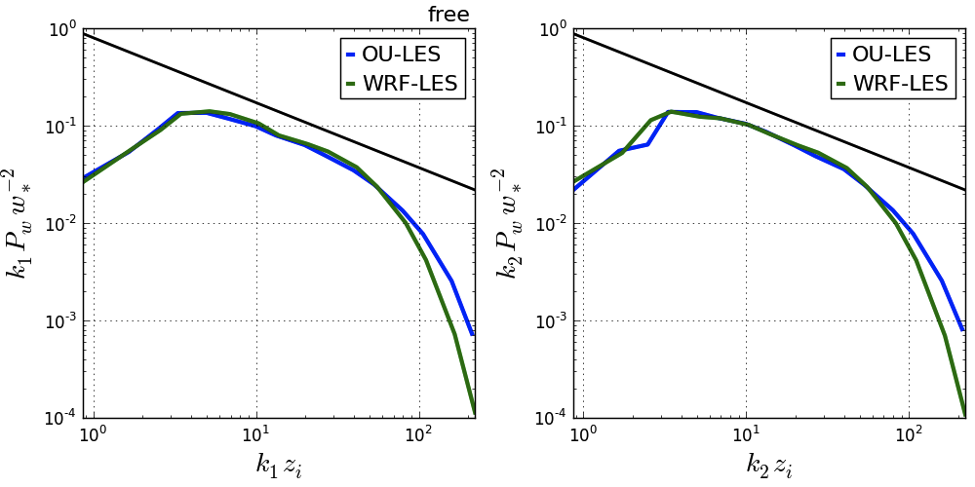
Discussion: Shear-Free
WRF-LES had slightly narrower inertial sub-range, less effective resolution, and sharper drop-off at high frequencies

Slide 31
Discussion: Shear-Driven
Visually, velocity patterns look similar

Slide 32
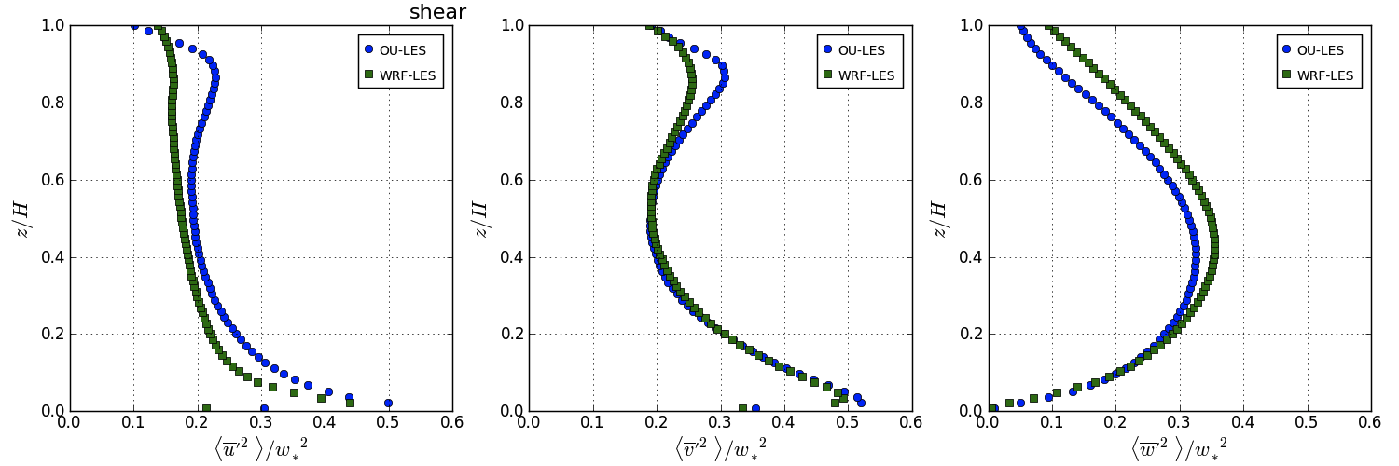
Discussion: Shear-Driven
WRF-LES produced smaller u-variance, TKE, & momentum flux - larger velocities

Slide 33
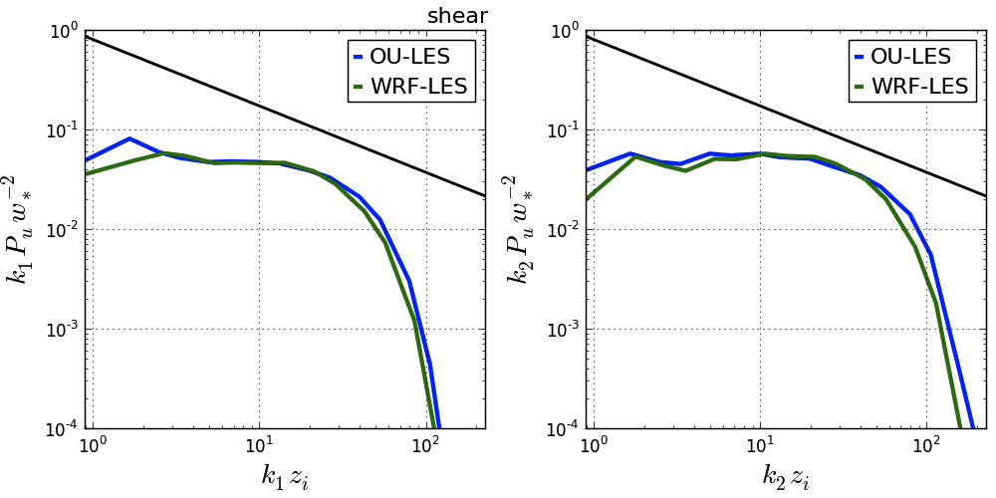
Discussion: Shear-Driven
Spectra show that k₁ spectra match more closely, but for k₂, similar behavior as in shear-free case
Notes:
For instance, air pollution applications, where dispersive role of small-scale motion may be very important, or wave propagation business, where structure-function parameter will not be right if small-scale motions are affected by numerical dissipation.

Slide 34
Discussion: Shear-Driven
2D spectra indicate that shear-induced, anisotropic effects are smudged out at small scales in WRF-LES
Notes:
For instance, air pollution applications, where dispersive role of small-scale motion may be very important, or wave propagation business, where structure-function parameter will not be right if small-scale motions are affected by numerical dissipation.

Slide 35
Idealized LES: Discussion
LES can be an expensive
WRF-LES (512x512x80) ~ 1200 proc. & 45 hrs.
OU-LES (512x512x80) ~ 1 proc. & 8-10 days
Output files ≥ 1 TB
Notes:
Energy-containing = turbulence producing
Flow features are potentially neither sufficiently resolved explicitly nor correctly represented statistically as subgrid-scale phenomena (Wyngaard 2004)

Slide 36
Idealized LES: Discussion
WRF-LES suffers from excessive numerical dissipation at small scales
Appears dependent on dominant flow type
May result from filters in the dynamics solver
Possibly affects larger scales
Notes:
Energy-containing = turbulence producing
Flow features are potentially neither sufficiently resolved explicitly nor correctly represented statistically as subgrid-scale phenomena (Wyngaard 2004)

Slide 37
Real-Data LES: Problems
Lateral boundaries are assumed periodic
Domains are generally disconnected from large-scale forcings & local terrain properties
OU-LES, for example, uses lower-order advection schemes
Notes:
1.) Periodic LBC condition not met in atmosphere
2.) Predictions are susceptible to drift from observations and often fail to reproduce sharp gradients observed in nature
3.) dispersive errors

Slide 38
Real-Data LES: Solutions
1.) WRF-LES nested in mesoscale WRF model
Specified lateral boundaries
Higher-order finite-difference scheme
2.) Nudged OU-LES
connects LES with realistic data from the larger-scale environment
retains local variability by only modifying background environment
Notes:
WRF-LES is convenient, one-stop shop

Slide 39
Nested WRF-LES: Setup
Simulation Type | PBL Scheme | Spacing (m) | Mesh Size | Time Step (s)
Mesoscale | YSU | 12,960 | 100x100x100 | 20
 |  | 4,320 | 100x100x100 | 5
 |  | 1,440 | 100x100x100 | 1
LES | WRF-LES | 480 | 100x100x100 | 4/5
 |  | 160 | 100x100x100 | 1/5
 |  | 40 | 201x201x100 | 1/20

Slide 40
Nudged OU-LES: Setup
Nudging profiles are linearly interpolated in time to current time step
That profile is subtracted from the plane-averaged LES profiles
The difference is modified by a nudging factor
That factor allows for an adjustment between the convective and diurnal time scales
Nudging tendency is applied at next time step
Notes:
Only modifies the background environment
Allows local variability to be retained

Slide 41
Case 1: June 7, 2007

Slide 42
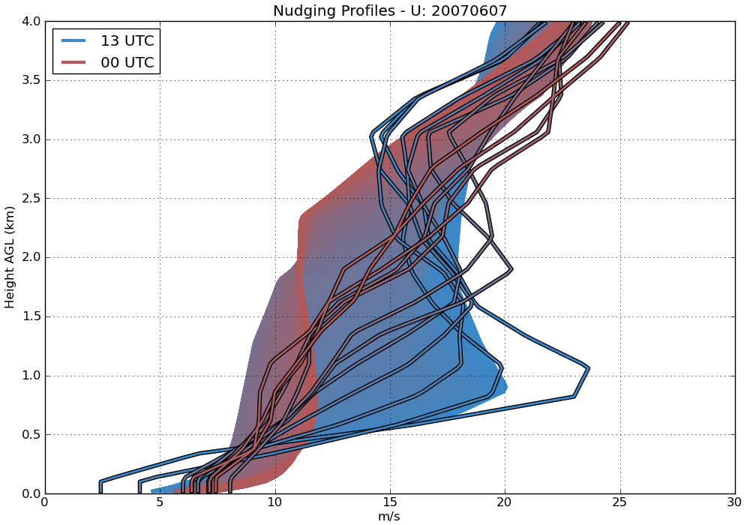
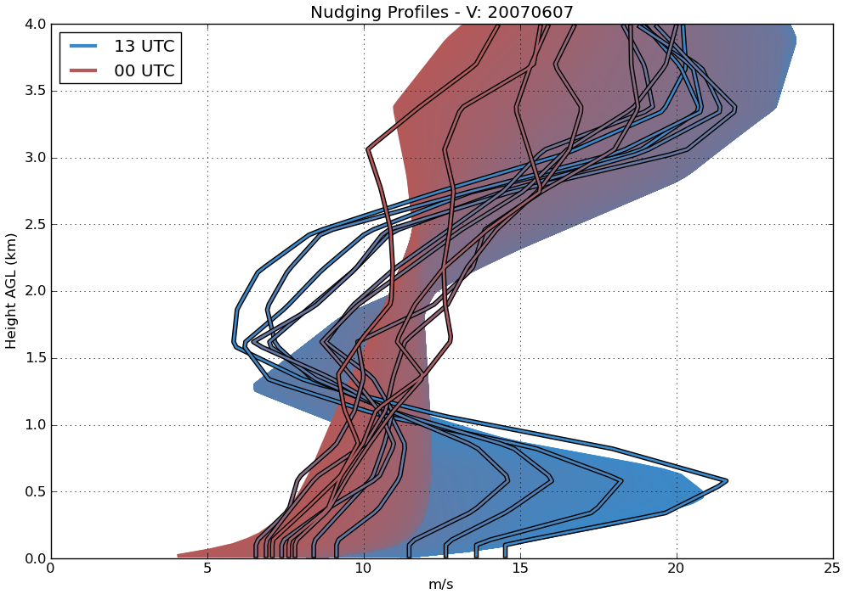
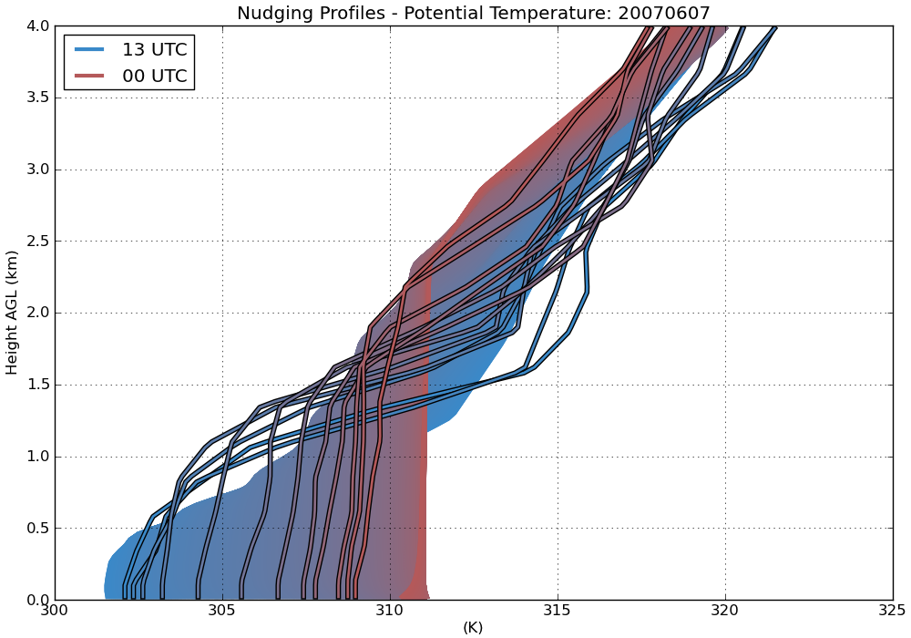
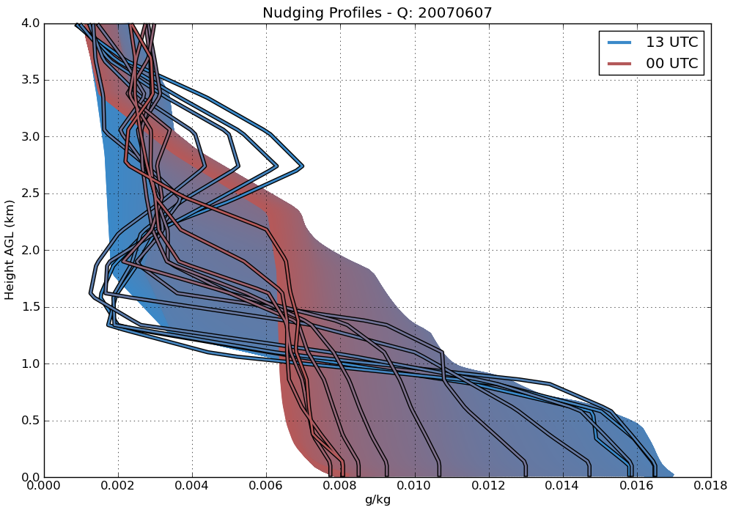
Case 1: nudging profiles
Notes:
Cheapest option

Slide 43
Case 1: meteogram
Notes:
Sample slice of final hour. Looks similar, right? Some signs of broader, less organized cellular convection for free, and slightly broader and elongated streaks in shear.

Slide 44
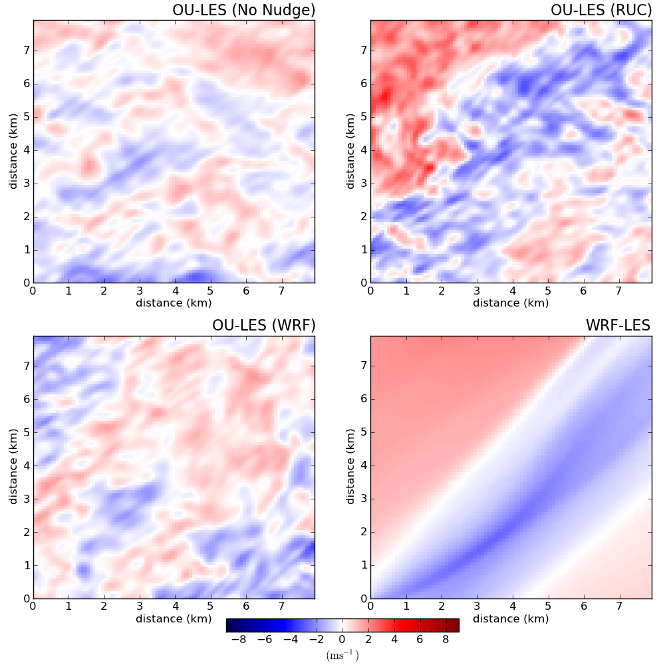
Case 1: u-component velocity (z/zi = 0.25)
Notes:
Sample slice of final hour. Looks similar, right? Some signs of broader, less organized cellular convection for free, and slightly broader and elongated streaks in shear.

Slide 45
Case 1: u-component 1D spectral density (z/zi=0.25)
Notes:
Sample slice of final hour. Looks similar, right? Some signs of broader, less organized cellular convection for free, and slightly broader and elongated streaks in shear.

Slide 46
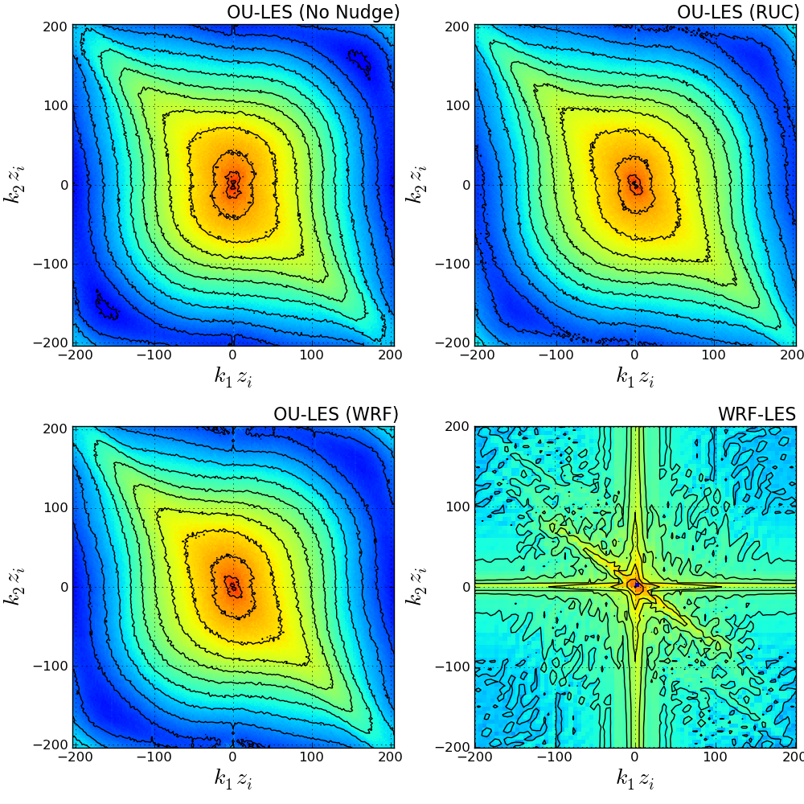
Case 1: u-component 2D spectral density (z/zi=0.25)
Notes:
Sample slice of final hour. Looks similar, right? Some signs of broader, less organized cellular convection for free, and slightly broader and elongated streaks in shear.

Slide 47
Case 2: October 26, 2008

Slide 48
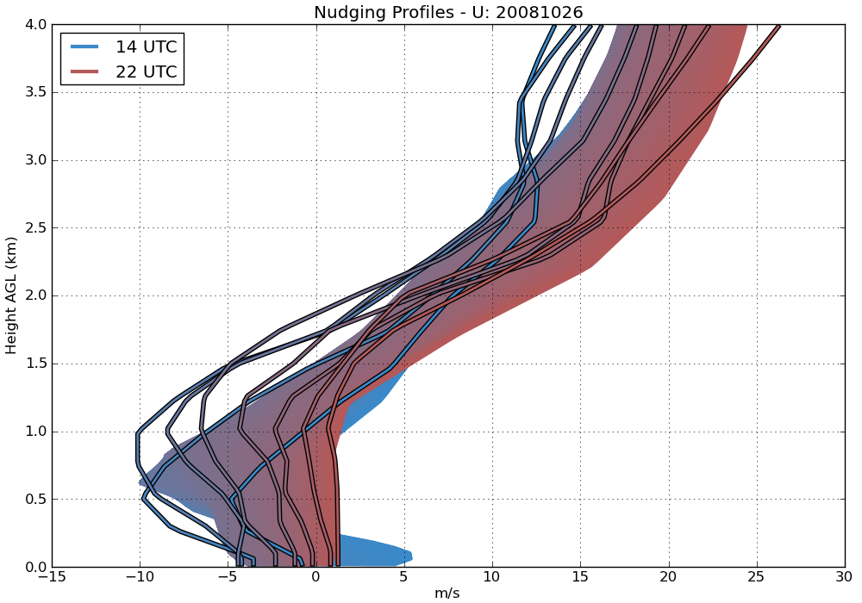
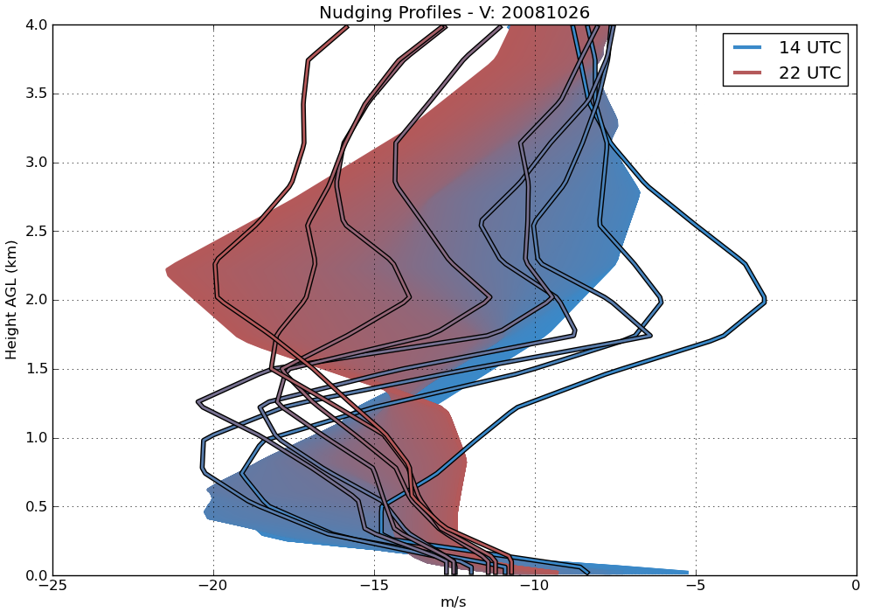
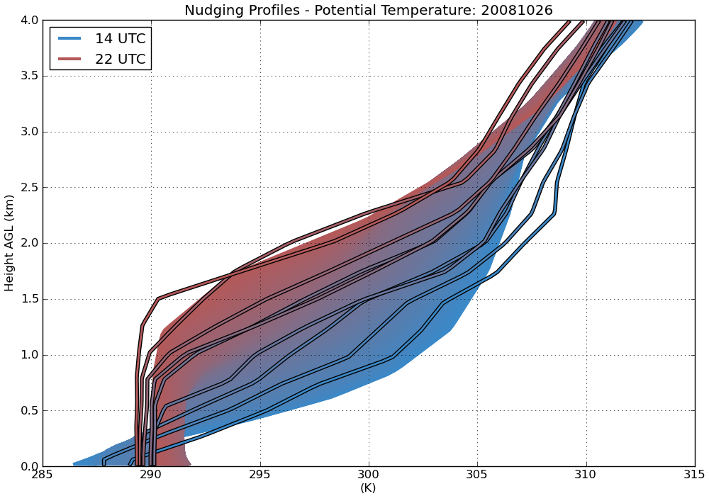
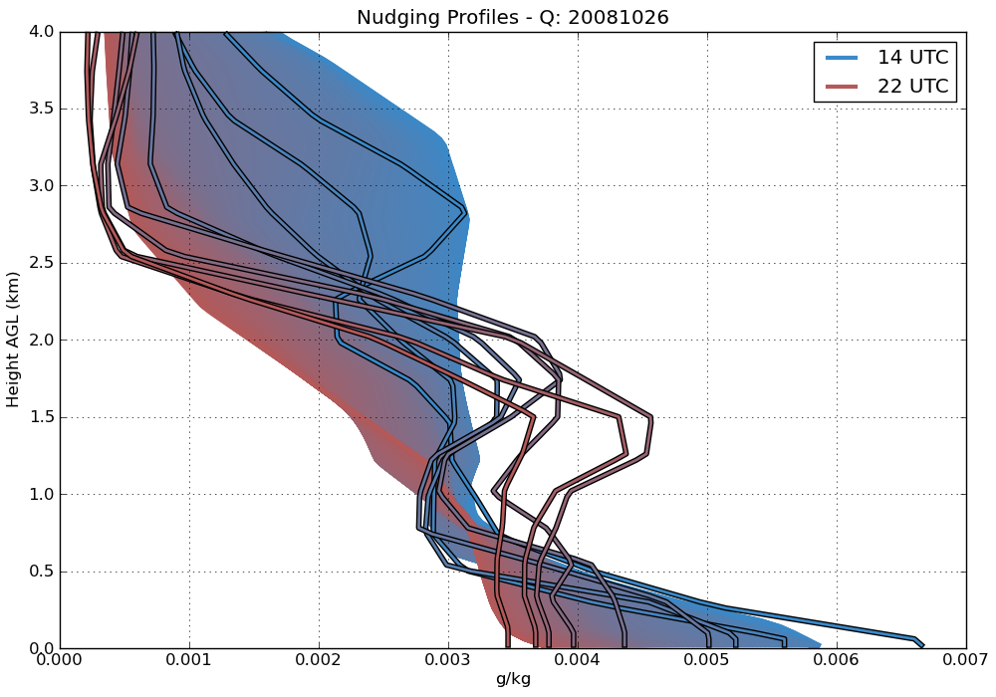
Case 2: nudging profiles
Notes:
Cheapest option

Slide 49
Case 2: meteogram
Notes:
Sample slice of final hour. Looks similar, right? Some signs of broader, less organized cellular convection for free, and slightly broader and elongated streaks in shear.

Slide 50
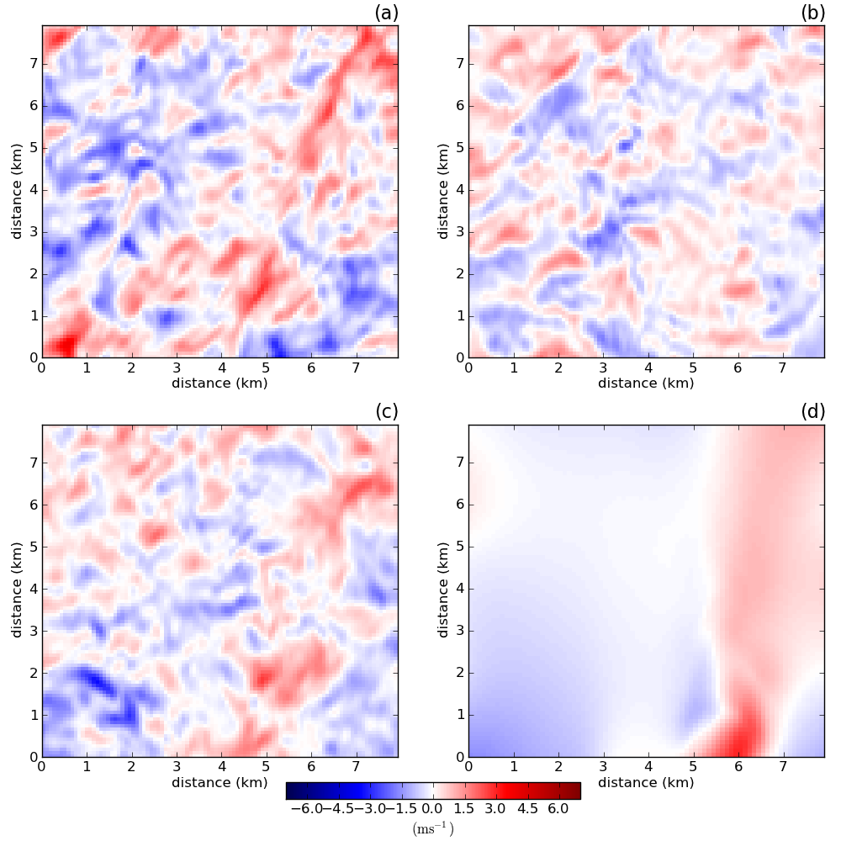
Case 2: u-component velocity (z/zi=0.25)
Notes:
Sample slice of final hour. Looks similar, right? Some signs of broader, less organized cellular convection for free, and slightly broader and elongated streaks in shear.

Slide 51
Case 2: u-component 1D spectral density (z/zi=0.25)
Notes:
Sample slice of final hour. Looks similar, right? Some signs of broader, less organized cellular convection for free, and slightly broader and elongated streaks in shear.

Slide 52
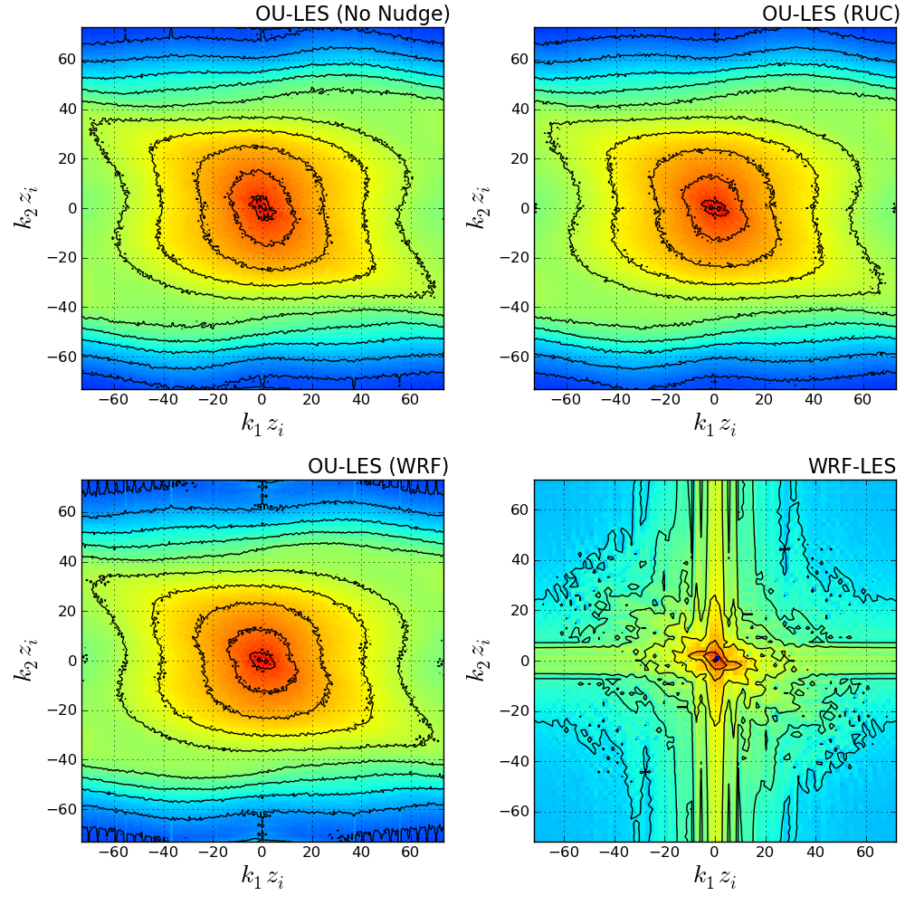
Case 2: u-component 2D spectral density (z/zi=0.25)
Notes:
Sample slice of final hour. Looks similar, right? Some signs of broader, less organized cellular convection for free, and slightly broader and elongated streaks in shear.

Slide 53
Nested WRF-LES: Discussion
Only two cases were shown due to instabilities in other cases
Split-nesting procedure is non-standard and potentially expensive
LES domains ~ 384 proc. & 40 hrs.
Notes:
Even with extremely conservative time step, WRF-LES domains would crash
Possibly due to limits on time step and the initial transition into turbulent flow

Slide 54
Nested WRF-LES: Discussion
Mean near-surface fields generally matched favorably with comparison data
Slices showed big streaks, no variability associated with atmospheric turbulence
Resulting high-order statistics were corrupted
WRF-LES fails to adequately reproduce spatial variability within sufficiently broad scale ranges
Notes:
Even with extremely conservative time step, WRF-LES domains would crash
Possibly due to limits on time step and the initial transition into turbulent flow

Slide 55
Nested WRF-LES: Discussion
Behavior possibly due to boundary effects
Matching SGS closures across nests is problematic
Coarser domains do not sufficiently resolve TKE
Model numerics may also pose problems
Required tradeoffs may limit the applicability of WRF-LES in particular real-data scenarios
Notes:
described in previous studies (Moeng et al. 2007; Mirocha 2010)
Not enough TKE to pass to iner domains, must spin up
Outer LES domains likely reside within problematic scale ranges

Slide 56
Nudged OU-LES: Discussion
How applicable this procedure is across scales and geographic locations remains a question for future study
Nudging procedure improves mean near-surface fields
Turbulence structures that OU-LES is known to confidently reproduce are retained
Notes:
that OU-LES is known to confidently reproduce

Slide 57
Nudged OU-LES: Discussion
Overall, the higher-resolution WRF-nudged simulations best accomplish this task
Best compromise in reproducing accurate bulk meteorological quantities and realistic turbulence statistics across a broad range of scales.
Notes:
in space and time

Slide 58
Summary
WRF-LES solves more physically robust equations, but filters affect scales of interest (and maybe others)
WRF-LES uses a higher-order advection scheme, but implicit diffusion term may also affect scales of interest
Notes:
in space and time

Slide 59
Summary
OU-LES uses periodic LBCs, which aren’t as physically relevant.
Specified boundaries and nesting in WRF-LES affect scales of interest
OU-LES may then be nudged, but the implementation is rather ad-hoc
Users must weight tradeoffs

